Slide 1






A User Recommendation System
By
Naif Alzahrani

Slide 2












BUSINESS IDEA
Amazon Sales
34%
Recommendations
Restaurants Recommendation System
Hospitality Industry
20% growth rate
Restaurants

Slide 3





The Data
WHAT?
WHO?
27000 reviews
192000 businesses
WORK
More Work
EDA
Examined documents
in micro detail

Slide 4

WORKFLOW
Preprocess
Vectorize
meaningful format
is at the heart of NLP
Remove punctuation
Convert documents to
bag of words vector representation
Tokenize
TFIDF
split documents
into lists of tokens
Remove stop words
Reflect how important a word is
to a document in a collection or corpus.

Slide 5
MODEL
STEP 1
STEP 2
Matrix Factorization
technique for unsupervised NLP
to break a large matrix down into the
combination of two smaller matrices
collaborative filtering method to find
the relationship between
items' and users' entities
STEP 3
STEP 4
Pickle
simply save your model on disc
and de-pickle it into your python
Test the end result and
Try to deploy

Slide 6

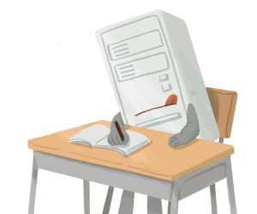
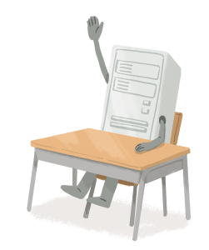


THE PROJECT
1
3
Chance to be your own boss
Difficulty in meeting
the deadline
2
4
Self-management lets you
build your own workflow
Develop a system that
Convert speech to text
and recommend

Slide 7

Demo

